Slide 1
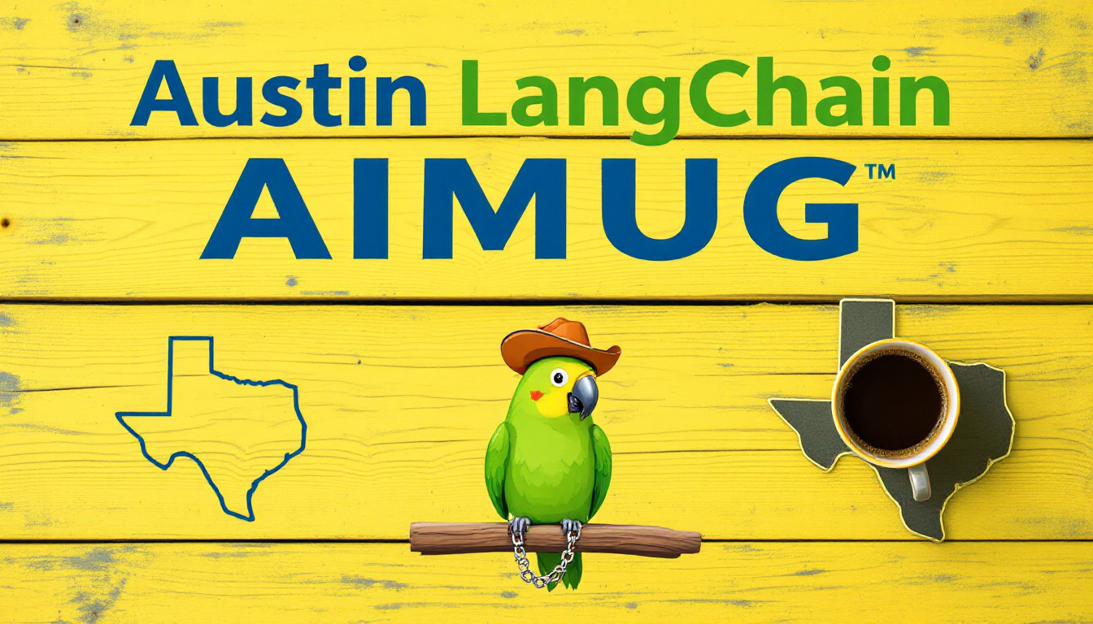


Slide 2

Todays Agenda
Intros
News
Lightning Talks
MCP Lab
Wrap up and after party upstairs at The Tavern

Slide 3
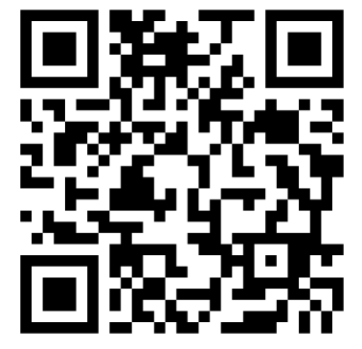
Thanks to our supporters
Center for Government and Civil Services – Space
LangChain – Pizza
Always Cool Brands – AV
Community -

Slide 4
HI , I’m Colin McNamara
Entrepreneur: Co-founder of Always Cool Brands, focusing on private-label products and health-conscious goods (LangChain User)
Founding Member: Austin LangChain AIMUG
10% Developer: Former Cloud Infrastructure lead with experience in hyper-scale cloud building, operations, engineering, and design.
Public Good: Helping our community succeed
LinkedIn:

Slide 5
Who we are
1100+ Members Strong: Connecting Austin’s tech, creative, and business leaders passionate about AI.
Learning in the Open: Leaning AI through the Lense of LangChain, pulling the ecosystem together.
Supportive & Engaged Community: A well-balanced Discord that’s "useful, but not overwhelming."

Slide 6
Learning in the Open – "Be Cool to Each Other" ✌️
Respect & Inclusivity: Our only rule is simple: “Be cool to each other, don’t be gross.”
AI Enthusiasts of All Levels Welcome: We celebrate diverse perspectives and unique paths in AI.

Slide 7
Where and when we meet 🌟📅
Monthly Showcases & Mixer - ACC RGC3000: Community members and vendors share projects, demos, and labs for hands-on learning.
Hacky Hours (Mid-Month) - Rotating Local Bars: Informal happy hours at local spots; meet, discuss, and relax.
Weekly Virtual Syncs - Online: Tuesdays & Thursdays at 2 PM – Workshopping, problem-solving, and AI discussions.

Slide 8
Where to Connect & Stay Updated 📲
Website: aimug.org – All things LangChain and AIMUG.
Discord: Join us for ongoing conversations.
GitHub: Austin LangChain Repo – Check out our open-source projects.
Meetup: Austin LangChain Group
Twitter: @AustinLangChain – Latest updates and AI news.
YouTube: Austin LangChain Channel – Watch replays and tutorials.

Slide 9
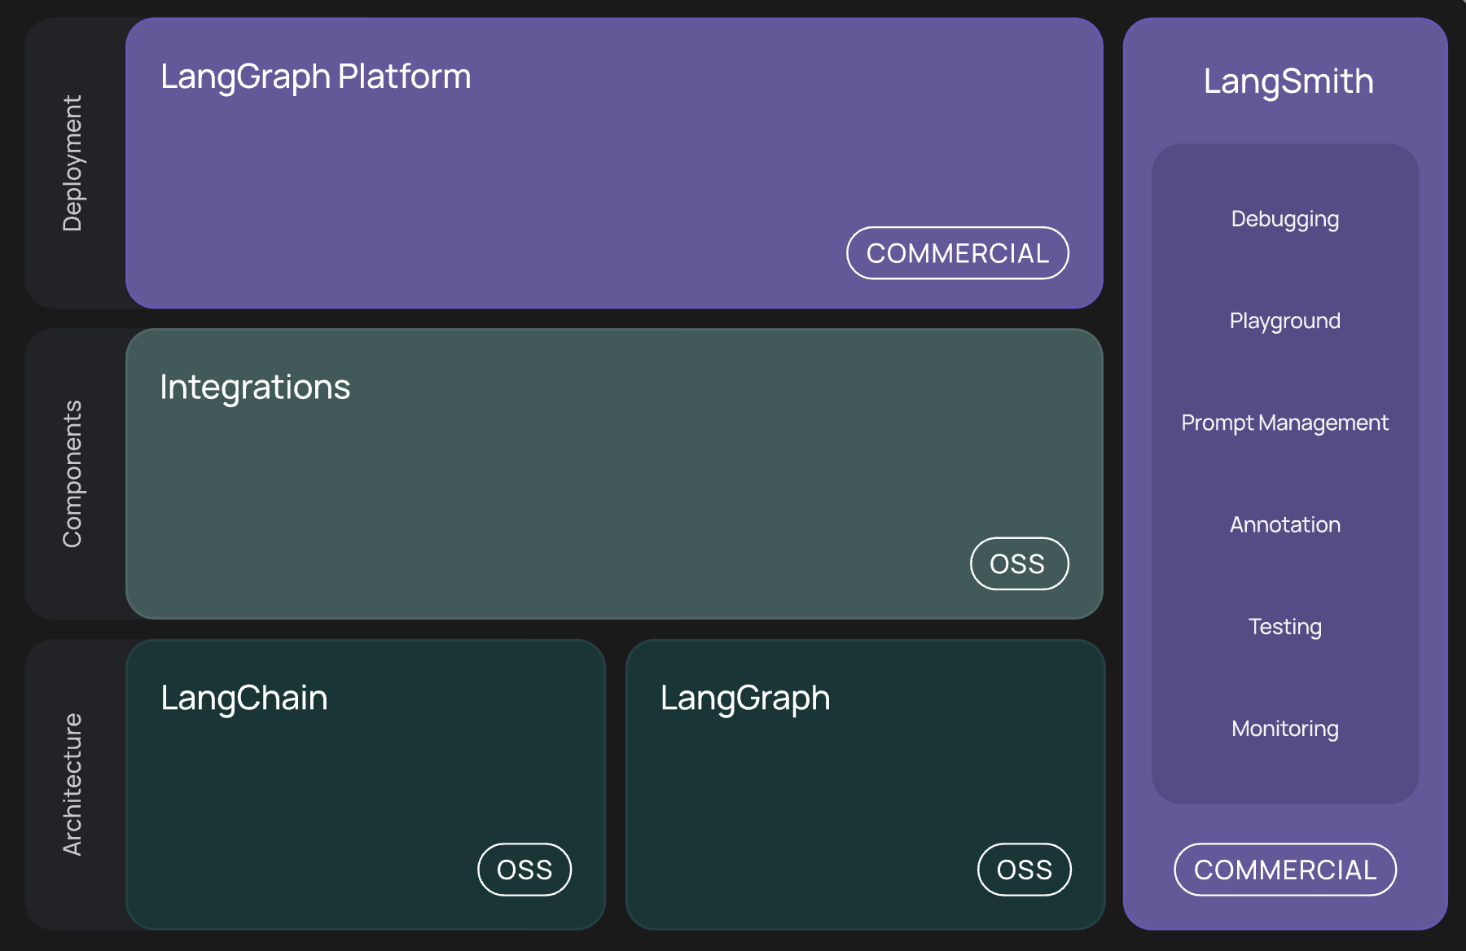
What’s LangChain

Slide 10
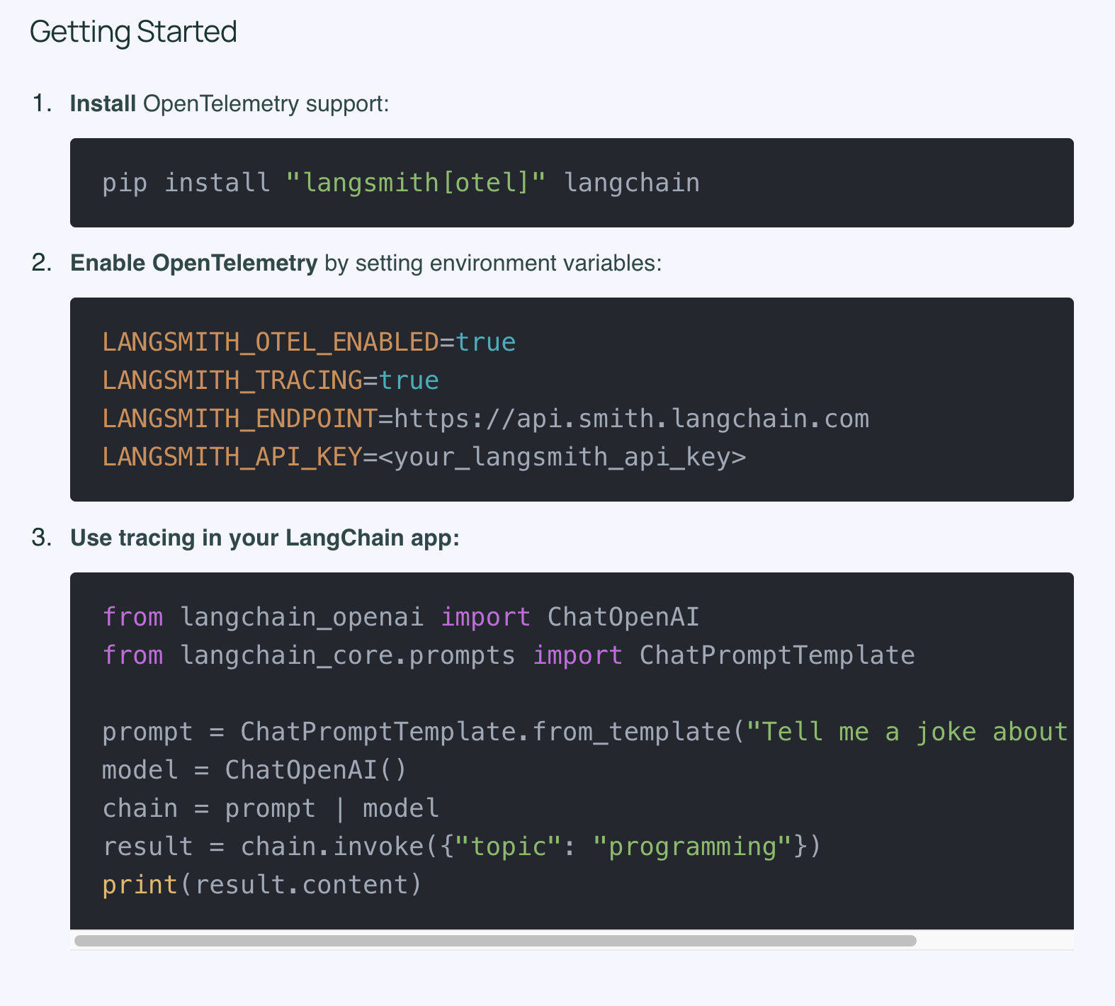
News – Open Telemetry Support
dsfasdf

Slide 11
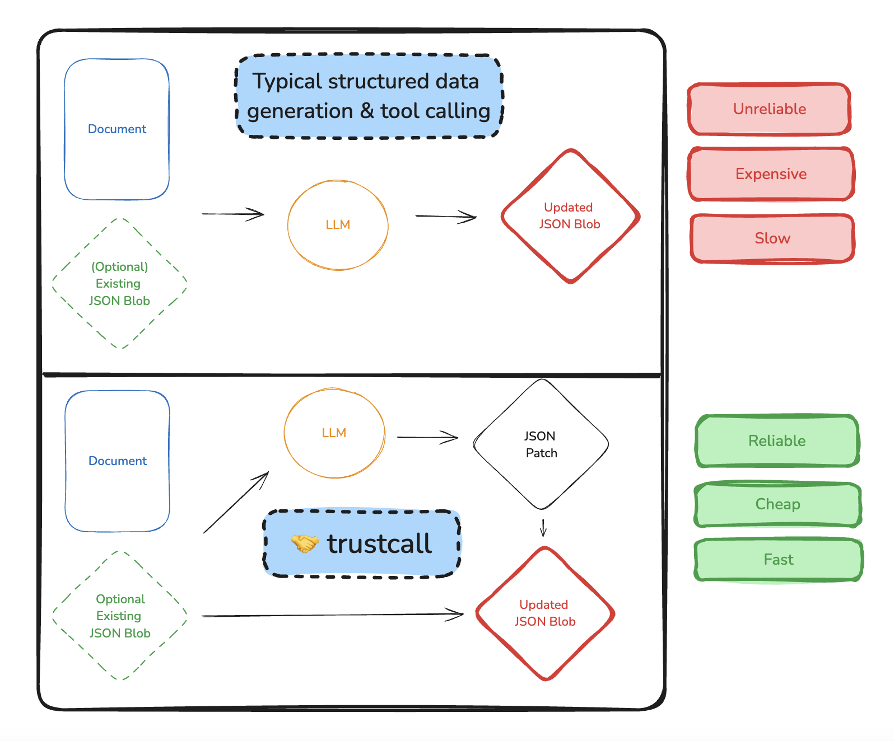
News – LangGraph 0.3 Pre-built Agents
Trustcall – Structured JSON Extraction
Supervisor – Multi-Agent starter kit
LangMem - Long Term Memory
Swarm – Swarm Multi-Agent Architecture

Slide 12
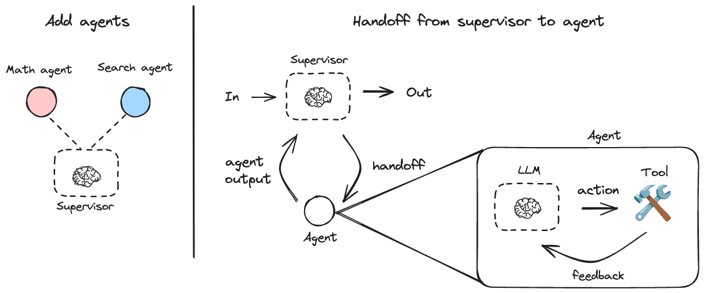
News – LangGraph 0.3 Pre-built Agents
Trustcall – Structured JSON Extraction
Supervisor – Multi-Agent starter kit
LangMem - Long Term Memory
Swarm – Swarm Multi-Agent Architecture

Slide 13
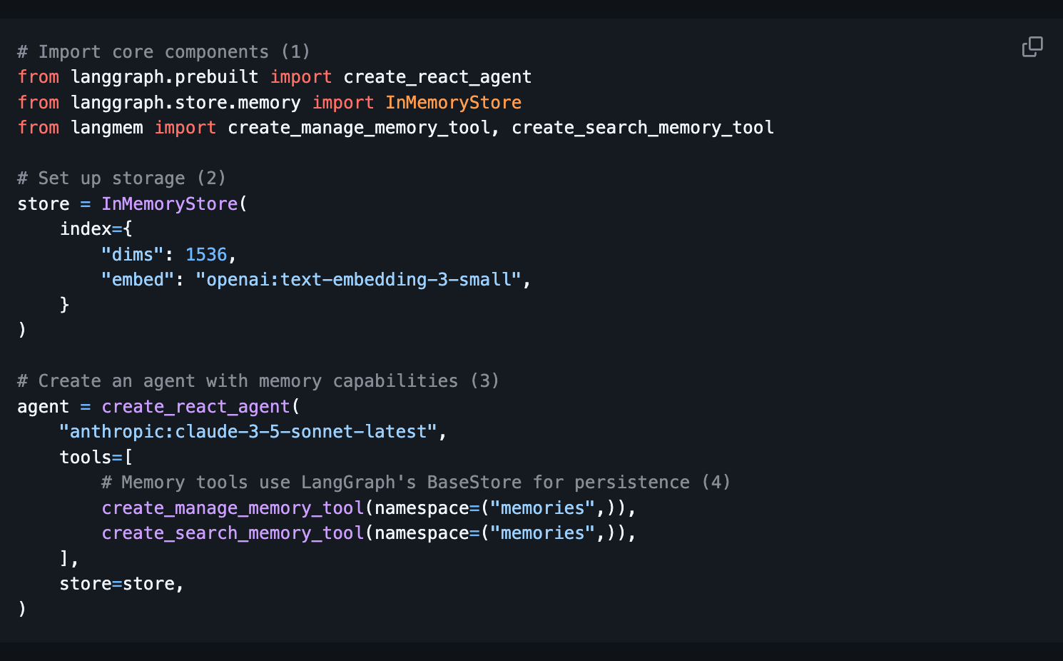
News – LangGraph 0.3 Pre-built Agents
Trustcall – Structured JSON Extraction
Supervisor – Multi-Agent starter kit
LangMem - Long Term Memory
Swarm – Swarm Multi-Agent Architecture

Slide 14
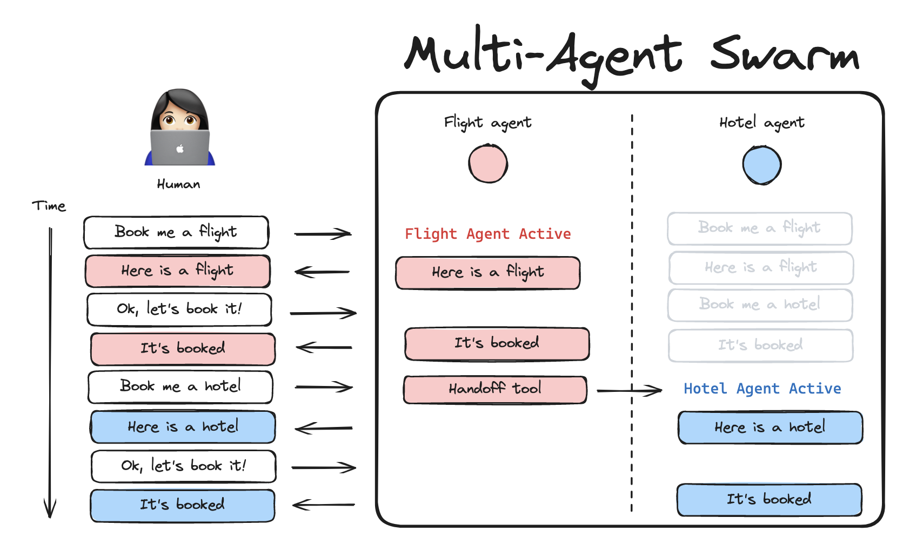
News – LangGraph 0.3 Pre-built Agents
Trustcall – Structured JSON Extraction
Supervisor – Multi-Agent starter kit
LangMem - Long Term Memory
Swarm – Swarm Multi-Agent Architecture

Slide 15
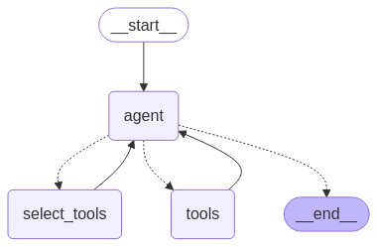
News – LangGraph BigTool (50 tools)
🧰 Scalable access to tools: Equip agents with hundreds or thousands of tools.
📝 Storage of tool metadata: Control storage of tool descriptions, namespaces, and other information through LangGraph's built-in persistence layer. Includes support for in-memory and Postgres backends.
💡 Customization of tool retrieval: Optionally define custom functions for tool retrieval.

Slide 16
News
dsfasdf

Slide 17
News
dsfasdf

Slide 18
Lightning Talks

Slide 19
MCP Lab

Slide 20
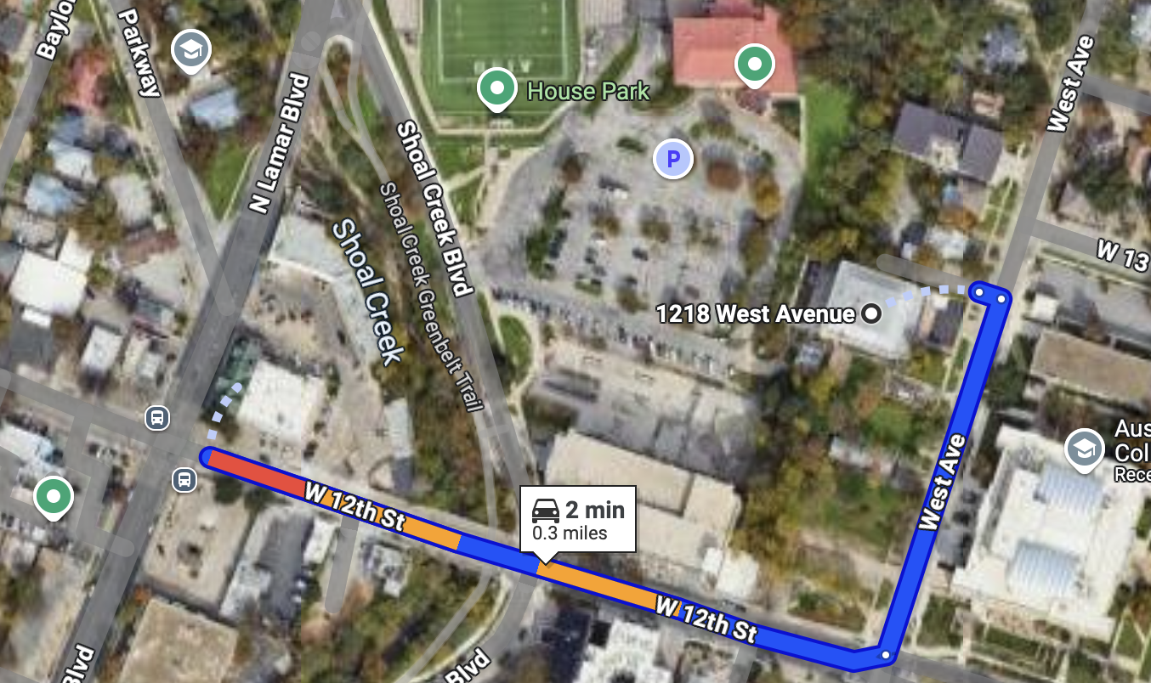
RGC-3000 and Tavern After Party
Website: aimug.org – All things LangChain and AIMUG.
Discord: Join us for ongoing conversations.
GitHub: Austin LangChain Repo – Check out our open-source projects.
Meetup: Austin LangChain Group
Twitter: @AustinLangChain – Latest updates and AI news.
YouTube: Austin LangChain Channel – Watch replays and tutorials.
ACC RGC3000
The Tavern
ACC Main Campus

Slide 21


Slide 22
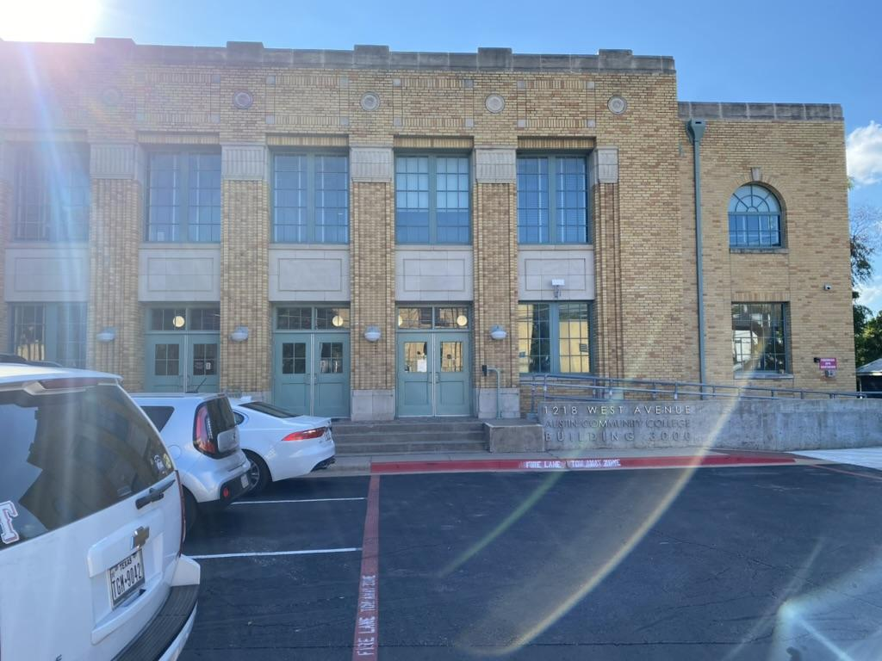
Finding US - ACC RGC-3000

Slide 23
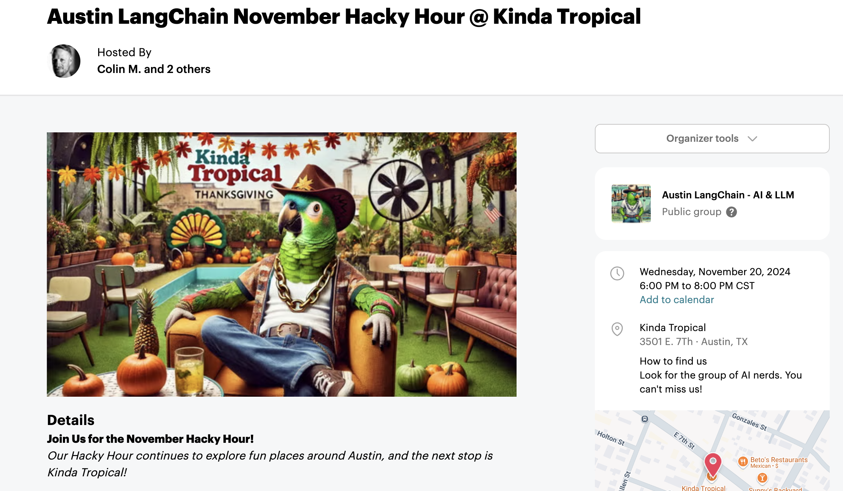
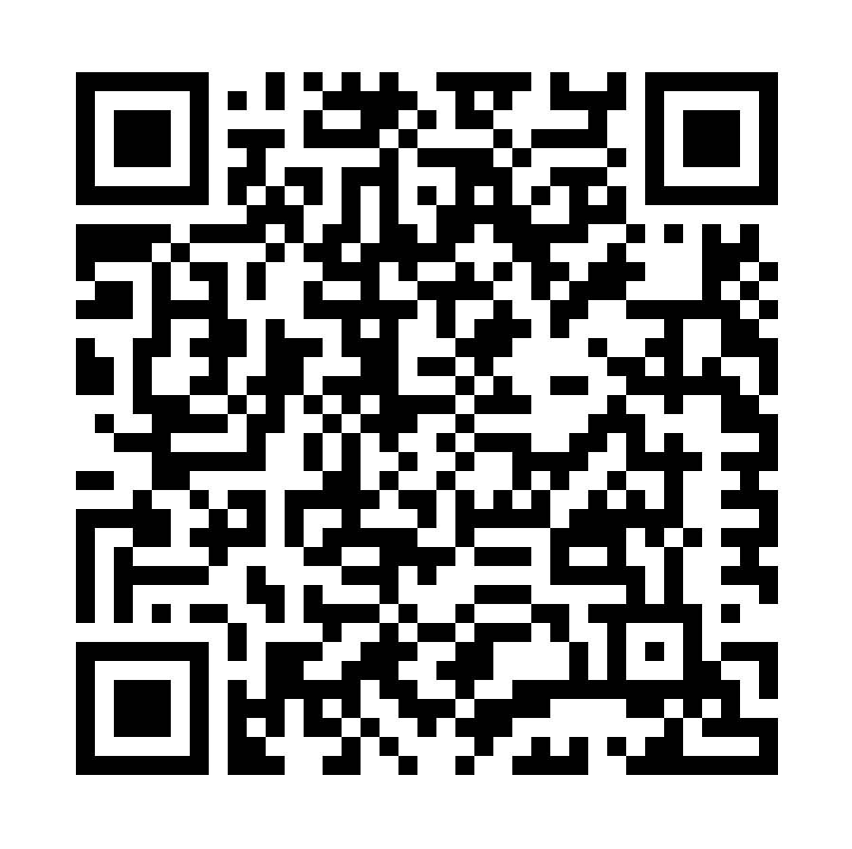
Next Event – Hacky Hour at Kinda Tropical
Respect & Inclusivity: Our only rule is simple: “Be cool to each other, don’t be gross.”
AI Enthusiasts of All Levels Welcome: We celebrate diverse perspectives and unique paths in AI.

